Slide 1
Lecture 6.3 - Embedding Methods for NLP Part 1: Unsupervised and Supervised Embeddings

Slide 2

The GPU Teaching Kit is licensed by NVIDIA and New York University under the
Creative Commons Attribution-NonCommercial 4.0 International License.
Deck credit: J. Weston
A.Bordes

Slide 3
What is a word embedding?
Suppose you have a dictionary of words.
The i^{th} word in the dictionary is represented by an embedding:
w_{i} ∈ R^{d}
i.e. a d -dimensional vector, which is learnt!
d typically in the range 50 to 1000.
Similar words should have similar embeddings (share latent features). Embeddings can also be applied to symbols as well as words (e.g.
Freebase nodes and edges).
Discuss later: can also have embeddings of phrases, sentences, documents, or even other modalities such as images.

Slide 4
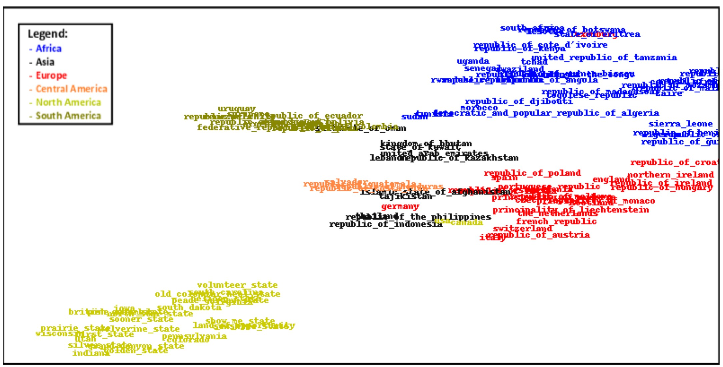
Learning an embedding space
Example of Embedding of 115 Countries (Bordes et al., ’11)

Slide 5
Main methods we highlight, ordered by date
Latent Semantic Indexing (Deerwester et al., ’88).
Neural Net Language Models (NN-LMs) (Bengio et al., ’06)
Convolutional Nets for tagging (SENNA) (Collobert & Weston, ’08).
Supervised Semantic Indexing (Bai et al, ’09).
Wsabie (Weston et al., ’10).
Recurrent NN-LMs (Mikolov et al., ’10).
Recursive NNs (Socher et al., ’11).
Word2Vec (Mikolov et al., ’13). Paragraph Vector (Le & Mikolov, ’14).
Overview of recent applications.

Slide 6
Main methods we highlight, ordered by topic
Embeddings for Ranking and Retrieval:
Latent Semantic Indexing (Deerwester et al., ’88). Supervised Semantic Indexing (Bai et al, ’09).
Wsabie (Weston et al., ’10).
Embeddings for Language Modeling (useful for speech, translation, . .):
Neural Net Language Models (NN-LMs) (Bengio et al., ’06)
Recurrent NN-LMs (Mikolov et al., ’10).
Word2Vec (Mikolov et al., ’13).
Embeddings for Supervised Prediction Tasks (POS, chunk, NER, SRL, sentiment, etc.):
Convolutional Nets for tagging (SENNA) (Collobert & Weston, ’08).
Recursive NNs (Socher et al., ’11).
Paragraph Vector (Le & Mikolov, ’14).

Slide 7
Main methods we highlight, ordered by topic
Embeddings for Ranking and Retrieval:
Latent Semantic Indexing (Deerwester et al., ’88). Supervised Semantic Indexing (Bai et al, ’09).
Wsabie (Weston et al., ’10).
Embeddings for Language Modeling (useful for speech, translation, . .):
Neural Net Language Models (NN-LMs) (Bengio et al., ’06)
Recurrent NN-LMs (Mikolov et al., ’10).
Word2Vec (Mikolov et al., ’13).
Embeddings for Supervised Prediction Tasks (POS, chunk, NER, SRL, sentiment, etc.):
Convolutional Nets for tagging (SENNA) (Collobert & Weston, ’08).
Recursive NNs (Socher et al., ’11).
Paragraph Vector (Le & Mikolov, ’14).

Slide 8
Ranking and retrieval: the goal
We want to learn to match a query (text) to a target (text).
Many classical supervised ranking methods use hand-coded features.
Methods like LSI that learn from words are unsupervised.
Supervised Semantic Indexing (SSI) uses supervised learning from text only:
Bai et al, Learning to Rank with (a Lot of) Word Features. Journal of Information Retrieval, ’09.
Outperforms existing methods (on words) like TFIDF, LSI or a (supervised) margin ranking perceptron baseline.

Slide 9
Basic bag-o’-words
Bag-of-words + cosine similarity:
Each doc. is a normalized bag-of-words.
Similarity with query q is:
Doesn’t deal with synonyms: bag vectors can be orthogonal
No machine learning at all

Slide 10
Latent semantic indexing (LSI)
Learn a linear embedding via a reconstruction objective.
Rank with:
Uses “synonyms”: low-dimensional latent “concepts”.
Unsupervised machine learning: useful for goal?
¹ f (q, d ) = q^{T}(U^{T}U + αI )d gives better results.
Also, usually normalize this → cosine similarity.

Slide 11
Supervised Semantic Indexing (SSI)
Basic model: rank with
i.e. learn weights of polynomial terms between documents.
Learn (huge!) with click-through data or other labels.
Uses “synonyms”
Supervised machine learning: targeted for goal
Too Big/Slow?! Solution = Constrain W :
low rank → embedding model!

Slide 12
SSI: why is this a good model?
Classical bag-of-words doesn't work when there are few matching terms:
q=(kitten, vet, nyc)
d=(cat, veterinarian, new, york)
Method q^{T}Wd learns that e.g. kitten and cat are highly related.
E.g. if i is the index of kitten and j is the index of cat, then Wij > 0 after training.

Slide 13
SSI: why the basic model sucks
W is big : 3.4Gb if D = 30000, 14.5Tb if D = 2.5M.
Slow: q^{T}Wd computation has mn computations q_{j}W_{ij}d_{i} , where q
and d have m and n nonzero terms.
Or one computes v = q^{T}W once, and then vd for each document. Classical speed where query has D terms, assuming W is dense → still slow.
One could minimize ||W ||₁ and attempt to make W sparse. Then at most mp times slower than classical model (with p nonzeros in a column.)

Slide 14
SSI improved model: Low rank W
Constrain W:
W = U^{T}V + I
U and V are N × D matrices → smaller
Low dimensional “latent concept” space like LSI (same speed). Differences: supervised, asymmetric, learns with I .
Variants:
W = I : bag-of-words again.
W = D, reweighted bag-of-words related to [Grangier and Bengio, 2005].
W = UTU + I : symmetric.

Slide 15
SSI: Training via maximizing AUC
Given a set of tuples R with a query q, a related document d⁺ and an unrelated (or lower ranked) document d⁻.
We would like f (q, d⁺) > f (q, d⁻).
Minimize margin ranking loss [Herbrich et al., 2000]:
Other options: batch gradient, parallel SGD (hogwild), Adagrad . . .
Learning algorithm stochastic gradient descent: fast & scalable
Iterate
Sample a triplet (q, d +, d−),
∂ + −
Update W ← W − λ max(0, 1 − f (q, d ) + f (q, d )).
∂W

Slide 16
Prior work: summary of learning to rank
[Grangier & Bengio, ’06] used similar methods to basic SSI for retrieving images.
[Goel, Langord & Strehl, ’08] used Hash Kernels (Vowpal Wabbit) for advert placement.
Main difference: we use low rank+CFH on W .
SVM [Joachims, 2002] and NN ranking methods [Burges, 2005] .
Use hand-coded features: title, body, URL, search rankings,. . . (don’t use words)
(e.g. Burges uses 569 features in all).
In contrast we use only the words and train on huge feature sets.
Several works on optimizing different loss functions (MAP, ROC, NDCG): [Cao, 2008], [Yu, 2007], [Qin, 2006],. . . .
Lots of stuff for “metric learning” problem as well..
One could also add features + new loss to this method ..

Slide 17
Experimental comparison
Wikipedia
1,828,645 documents. 24,667,286 links.
Split into 70% train, 30% test.
Pick random doc. as query, then rank other docs.
Docs that are linked to it should be highly ranked. Two setups:
whole document is used as query;
5,10 or 20 words are picked to mimic keyword search.

Slide 18
Wikipedia experiments: document retrieval performance
Experiments on Wikipedia, which still contains 2 million documents: retrieval task using the link structure and separated the data into 70% for training and 30% for test.
Document based retrieval:
k -keywords based retrieval:
Algorithm | Rank-Loss | MAP | P10
TFIDF αLSI + (1 − α)TFIDF | 0.842% 0.721% | 0.432±0.012 0.433 | 0.193 0.193
Linear SVM Ranker | 0.410% | 0.477 | 0.212
Hash Kernels + αI | 0.322% | 0.492 | 0.215
Wsabie + αI | 0.158% | 0.547±0.012 | 0.239±0.008
k = 5: Algorithm | Params | Rank | MAP | P@10
TFIDF | 0 | 21.6% | 0.047 | 0.023
αLSI + (1 − α)TFIDF | 200D+1 | 14.2% | 0.049 | 0.023
Wsabie + αI | 400D | 4.37% | 0.166 | 0.083

Slide 19
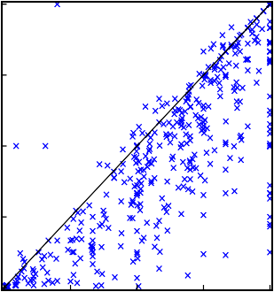
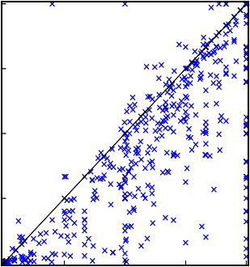
Scatter plots: SSI vs. TFIDF and LSI
Mean Average Precision for TFIDF and SSI_30k+I
1
Mean Average Precision for LSI and SSI_30k+I
1
alpha*LSI_30k+(1-alpha)*TFIDF_2.5M
0.75
0.75
TFIDF
0.5
0.5
0.25
0.25
0
0
0.25 0.5
SSI_30k+I
0.75
1
0
0
0.25
0.5 0.75
SSI_30k+I
1
(a) (b)
Figure: Scatter plots of Average Precision for 500 documents:
(a) SSI vs. TFIDF, (b) SSI vs. αLSI + (1 − α) TFIDF.

Slide 20
Experiments: cross-language retrieval
Retrieval experiments using a query document in Japanese, where the task
is to retrieve documents in English (using link structure as ground truth).
SSI can do this without doing a translation step first as it learns to map the two languages together in the embedding space.
D = 30,000
Some recent related translation-based embeddings: (Hermann & Blunsom, ICLR ’14) and (Mikolov et al., ’13).
Algorithm | Rank-Loss | MAP | P10
TFIDF_{EngEng} (Google translated queries) | 4.78% | 0.319 | 0.259
αLSI_{EngEng} +(1 − α)TFIDF_{EngEng} | 3.71% | 0.300 | 0.253
αCL-LSI_{JapEng} +(1 − α)TFIDF_{EngEng} | 3.31% | 0.275 | 0.212
SSIEngEng | 1.72% | 0.399 | 0.325
SSIJapEng | 0.96% | 0.438 | 0.351
αSSI_{JapEng} + (1 − α)TFIDF_{EngEng} | 0.75% | 0.493 | 0.377
αSSI_{JapEng} + (1 − α)SSI_{EngEng} | 0.63% | 0.524 | 0.386

Slide 21
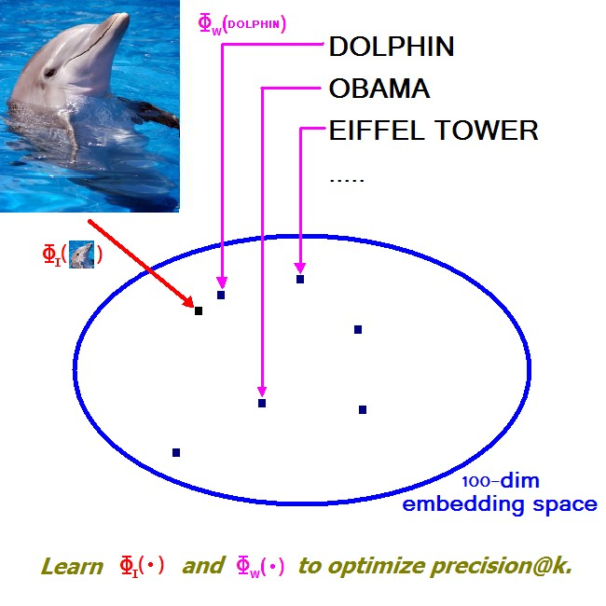
Wsabie (Weston, Usunier, Bengio, ’10)
Extension to SSI, also embeds objects other than text, e.g. images.
WARP loss function that optimizes precision@k.

Slide 22
Joint item-item embedding model
L.H.S: Image, query string or user profile (depending on the task)
Φ_{LHS} (x ) = UΦ_{x} (x ) : R^{dx} → R¹⁰⁰.
R.H.S: document, image, video or annotation (depending on the task)
Φ_{RHS} (y ) = V Φ_{y} (y ) : R^{dy} → R¹⁰⁰.
This model again compares the degree of match between the L.H.S and R.H.S in the embedding space:
f_{y} (x ) = sim(Φ_{LHS} (x ), Φ_{RHS} (y )) = Φ_{x} (x )^{T}U^{T}V Φ_{y} (y )
Also constrain the weights (regularize):
||U_{i} ||₂ ≤ C, i = 1, . . . , d_{x} , ||V_{i} ||₂ ≤ C, i = 1, . . . , d_{y} .

Slide 23
Ranking annotations: AUC is suboptimal
Classical approach to learning to rank is maximize AUC by minimizing:
Problem: All pairwise errors are considered the same, it counts the number of ranking violations.
Example:
Function 1: true annotations ranked 1st and 101st.
Function 2: true annotations ranked 50th and 52nd.
AUC prefers these equally as both have 100 “violations”.
We want to optimize the top of the ranked list!

Slide 24
Rank weighted loss [Usunier et al. ’09]
Replace classical AUC optimization:
With weighted version:
where rank_{y} (f (x)) is the rank of the true label:
and L(η) converts the rank to a weight, e.g

Slide 25
Weighted Approximate-Rank Pairwise (WARP) loss
Problem: we would like to apply SGD:
. . . too expensive to compute per (x, y ) sample as y ∈ Y is large.
Solution: approximate by sampling fi (x ) until we find a violating label y¯
where N is the number of trials in the sampling step.

Slide 26
Online WARP loss

Slide 27
Image Annotation Performance
Algorithm | 16k ImageNet | 22k ImageNet | 97k Web Data
Nearest Means | 4.4% | 2.7% | 2.3%
One-vs-all SVMs 1+:1- | 4.1% | 3.5% | 1.6%
One-vs-all SVMs | 9.4% | 8.2% | 6.8%
AUC SVM Ranker | 4.7% | 5.1% | 3.1%
Wsabie | 11.9% | 10.5% | 8.3%
Training time: WARP vs. OWPC-SGD & AUC
Training time WARP vs AUC vs OWPC-SGD on ImageNet
0.014
0.012
0.01
0.008
0.006
0.004
0.002
0
WARP
AUC OWPC-SGD
Test Precision@Top10
0 5 10 15 20 25 30 35
hours

Slide 28
Learned annotation embedding (on web data)
Annotation | Neighboring Annotations
barack obama david beckham santa | barak obama, obama, barack, barrack obama, bow wow beckham, david beckam, alessandro del piero, del piero santa claus, papa noel, pere noel, santa clause, joyeux noel
dolphin cows | delphin, dauphin, whale, delfin, delfini, baleine, blue whale cattle, shire, dairy cows, kuh, horse, cow, shire horse, kone
rose pine tree | rosen, hibiscus, rose flower, rosa, roze, pink rose, red rose abies alba, abies, araucaria, pine, neem tree, oak tree
mount fuji eiffel tower | mt fuji, fuji, fujisan, fujiyama, mountain, zugspitze eiffel, tour eiffel, la tour eiffel, big ben, paris, blue mosque
ipod f18 | i pod, ipod nano, apple ipod, ipod apple, new ipod f 18, eurofighter, f14, fighter jet, tomcat, mig 21, f 16

Slide 29
Summary
Conclusion
Powerful: supervised methods for ranking. Outperform classical methods
Efficient low-rank models → learn hidden representations.
Embeddings good for generalization, but can “blur” too much e.g. for exact word matches.
Extensions
Nonlinear extensions – e.g. convolutional net instead.

Slide 30
Main methods we highlight, ordered by topic.
Embeddings for Ranking and Retrieval:
Latent Semantic Indexing (Deerwester et al., ’88). Supervised Semantic Indexing (Bai et al, ’09).
Wsabie (Weston et al., ’10).
Embeddings for Language Modeling (useful for speech, translation)
Neural Net Language Models (NN-LMs) (Bengio et al., ’06)
Recurrent NN-LMs (Mikolov et al., ’10).
Word2Vec (Mikolov et al., ’13).
Embeddings for Supervised Prediction Tasks (POS, chunk, NER, SRL, sentiment, etc.):
Convolutional Nets for tagging (SENNA) (Collobert & Weston, ’08).
Recursive NNs (Socher et al., ’11).
Paragraph Vector (Le & Mikolov, ’14).

Slide 31
Language modeling
Task: given a sequence of words, predict the next word.
the cat sat on the ??
n-gram models are a strong baseline on this task.
A variety of embedding models have been tried, they can improve results.
The embeddings learnt from this unsupervised task can also be used to transfer to and improve a supervised task.

Slide 32
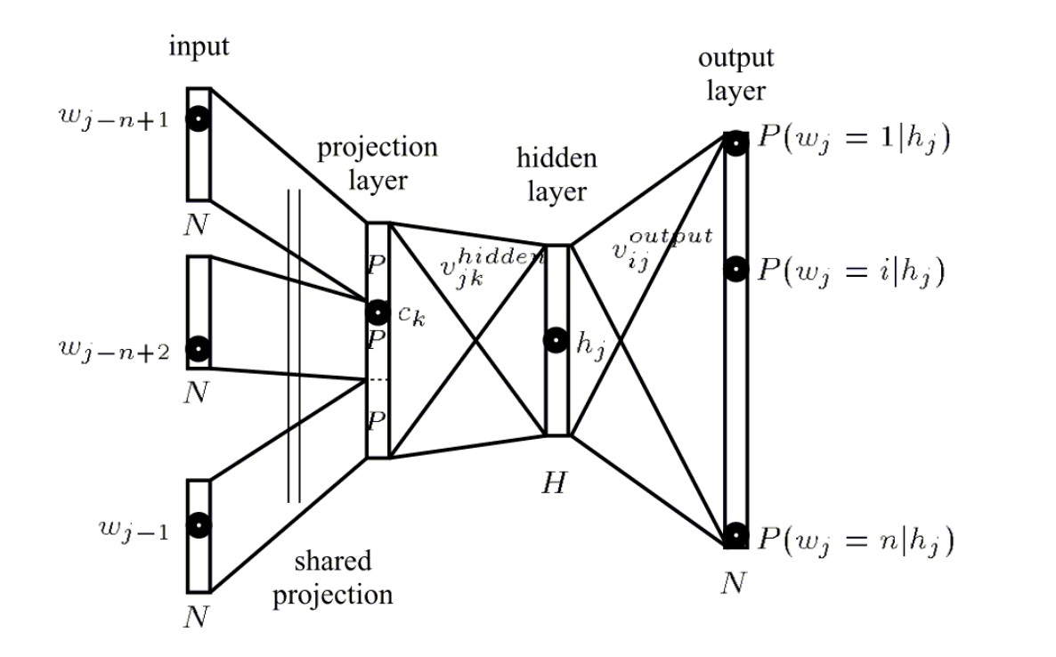
Neural network language models
Bengio, Y., Schwenk, H., Sencal, J. S., Morin, F., & Gauvain, J. L. (2006). Neural probabilistic language models. In Innovations in Machine Learning (pp. 137-186). Springer Berlin Heidelberg.

Slide 33
Neural Network Language Models:
Hierarchical Soft Max Trick (Morin & Bengio ’05)
Predicting the probability of each next word is slow in NNLMs because the output layer of the network is the size of the dictionary.
Can predict via a tree instead:
Cluster the dictionary either according to semantics (similar words in the same cluster) or frequency (common words in the same cluster). This gives a two-layer tree, but a binary tree is another possibility.
The internal nodes explicitly model the probability of its child nodes.
The cost of predicting the probability of the true word is now: traversal to the child, plus normalization via the internal nodes and children in the same node.
This idea is used in Word2Vec and RNN models as well.

Slide 34
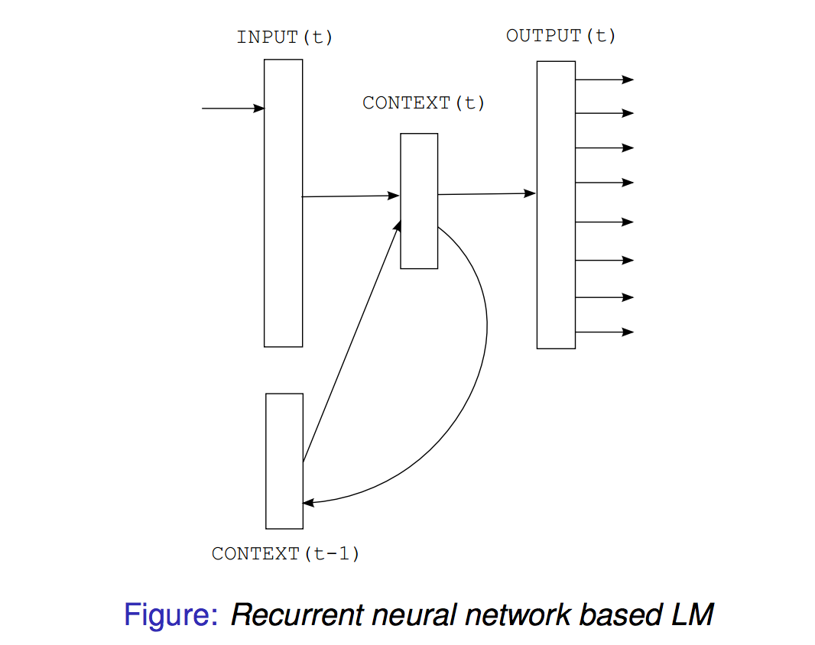
Recurrent neural network language models
Key idea: input to predict next word is current word plus context fed-back from previous word (i.e. remembers the past with recurrent connection).
Recurrent neural network based language model. Mikolov et al., Interspeech, ’10.

Slide 35
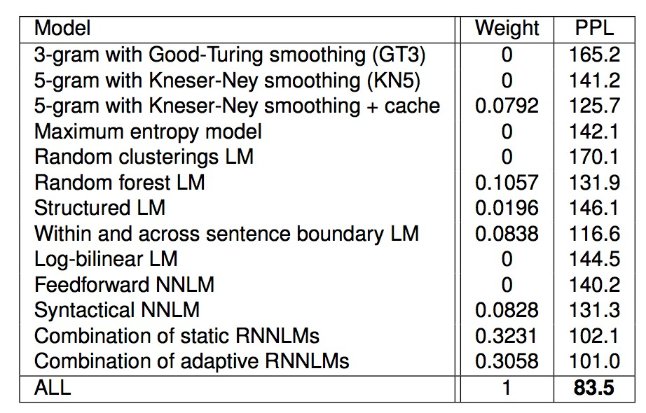
NNLMS vs. RNNS: Penn Treebank results (Mikolov)
Recent uses of NNLMs and RNNs to improve machine translation:
Fast and Robust NN Joint Models for Machine Translation, Devlin et al, ACL ’14.
Also Kalchbrenner ’13, Sutskever et al., ’14., Cho et al., ’14.

Slide 36
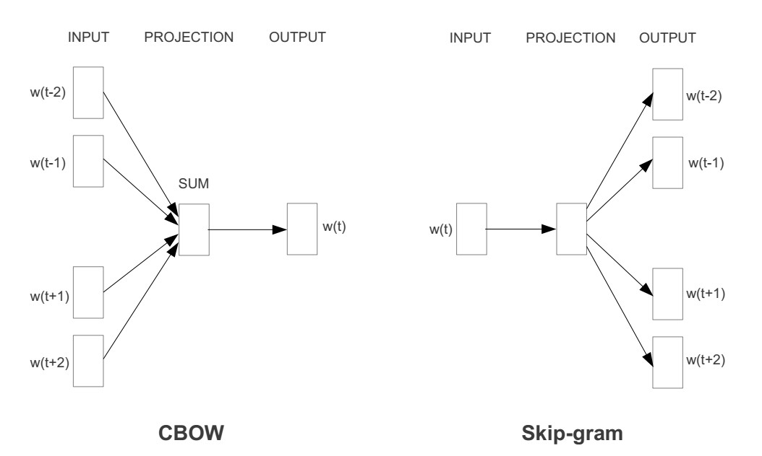
Word2Vec: very simple LM, works well
Tomas Mikolov, Ilya Sutskever, Kai Chen, Greg Corrado, and Jeffrey Dean. Distributed Representations of Words and Phrases and their Compositionality. NIPS, 2013.

Slide 37
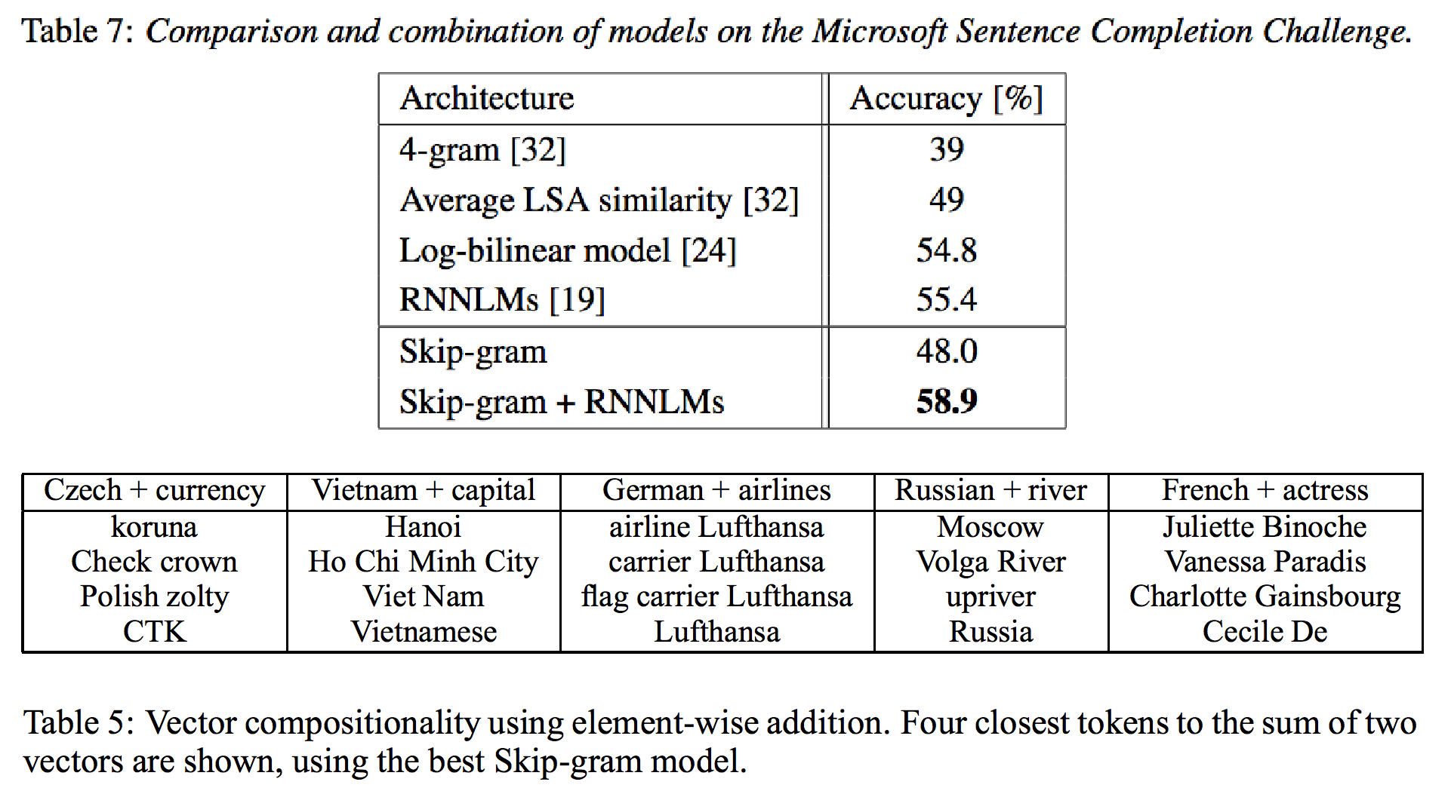
Word2Vec: compositionality
Table 7: comparison and combination of models on the Microsoft Sentence Completion Challenge.
Table 5: Vector compositionality using element-wise addition. Four closest tokens to the sum of two vectors are shown, using the best Skip-gram model.
Code: https://code.google.com/p/word2vec/

Slide 38
Main methods we highlight, ordered by topic
Embeddings for Ranking and Retrieval:
Latent Semantic Indexing (Deerwester et al., ’88). Supervised Semantic Indexing (Bai et al, ’09).
Wsabie (Weston et al., ’10).
Embeddings for Language Modeling (useful for speech, translation, . .):
Neural Net Language Models (NN-LMs) (Bengio et al., ’06)
Recurrent NN-LMs (Mikolov et al., ’10).
Word2Vec (Mikolov et al., ’13).
Embeddings for Supervised Prediction Tasks (POS, chunk, NER, SRL, sentiment, etc.):
Convolutional Nets for tagging (SENNA) (Collobert & Weston, ’08).
Recursive NNs (Socher et al., ’11).
Paragraph Vector (Le & Mikolov, ’14).

Slide 39
NLP tasks
Part-Of-Speech Tagging (POS): syntactic roles (noun, adverb...) Chunking: syntactic constituents (noun phrase, verb phrase...)
Name Entity Recognition (NER): person/company/location...
Semantic Role Labeling (SRL):
[John]_{ARG0} [ate]_{REL} [the apple]_{ARG1} [in the garden]_{ARGM−LOC}
Complex systems
Large scale engineering: design a lot of complex features, use a fast existing linear machine learning algorithm
Large scale machine learning: use simple features, design a complex model which will implicitly learn the right features

Slide 40
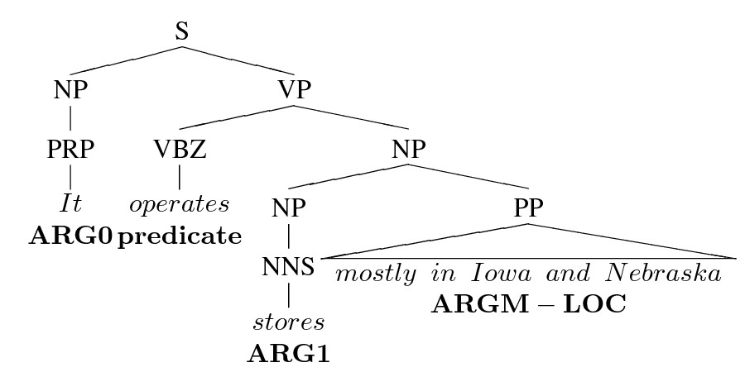
The large scale feature engineering way
Extract hand-made features e.g. from the parse tree
Disjoint: all tasks trained separately, Cascade features
Feed these features to a shallow classifier like SVM

Slide 41
ASSERT: many hand built features for SRL (Pradhan et al, ’04)
Problems:
Features rely on other solutions (parsing, named entity, word-sense)
Technology task-transfer is difficult
Choose some good hand-crafted features
Feed them to a shallow classifier like SVM
Predicate and POS tag of predicate
Phrase type: adverbial phrase, prepositional phrase, . . . Head word and POS tag of the head word
Path: traversal from predicate to constituent Word-sense disambiguation of the verb
Length of the target constituent (number of words) Partial Path: lowest common ancestor in path
First and last words and POS in constituents Constituent tree distance
Dynamic class context: previous node labels Constituent relative features: head word Constituent relative features: siblings
Voice: active or passive (hand-built rules) Governing category: Parent node’s phrase type(s) Position: left or right of verb
Predicted named entity class Verb clustering
NEG feature: whether the verb chunk has a ”not” Head word replacement in prepopositional phrases Ordinal position from predicate + constituent type Temporal cue words (hand-built rules)
Constituent relative features: phrase type Constituent relative features: head word POS Number of pirates existing in the world. . .

Slide 42
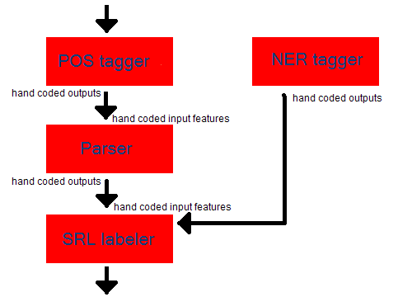

The Suboptimal (?) Cascade

Slide 43
NLP: large scale machine learning
Goals
Task-specific engineering limits NLP scope
Can we find unified hidden representations?
Can we build unified NLP architecture?
Means
Start from scratch: forget (most of) NLP knowledge
Compare against classical NLP benchmarks
Our dogma: avoid task-specific engineering

Slide 44
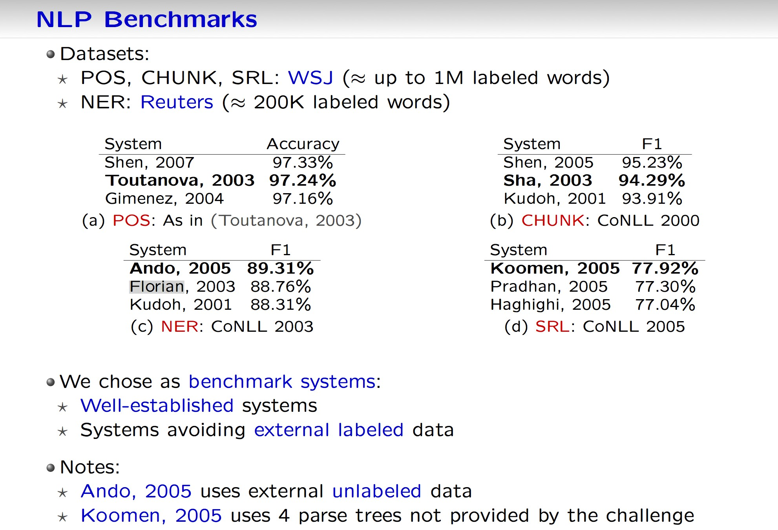
NLP benchmarks
Datasets:
POS, CHUNK, SRL: WSJ (= up to 1M labeled words)
NER: Reuters (= 200K labeled words)
We chose as benchmark systems:
Well-established systems
Systems avoiding external labeled data
Notes:
Ando, 2005 uses external unlabeled data
Koomen, 2005 uses 4 parse trees not provided by the challenge

Slide 45
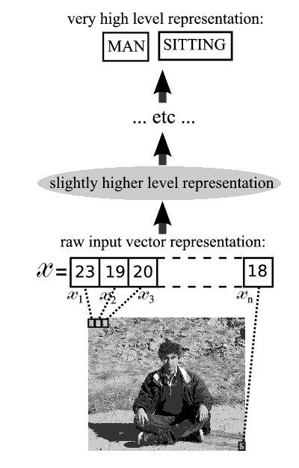
The “deep learning” way
Deep approach attempts to propose a radically different end-to-end approach:
Avoid building a parse tree. Humans don’t need this to talk.
Try to avoid all hand-built features → monolithic systems.
Humans implicitly learn these features. Neural networks can too. . . ?

Slide 46
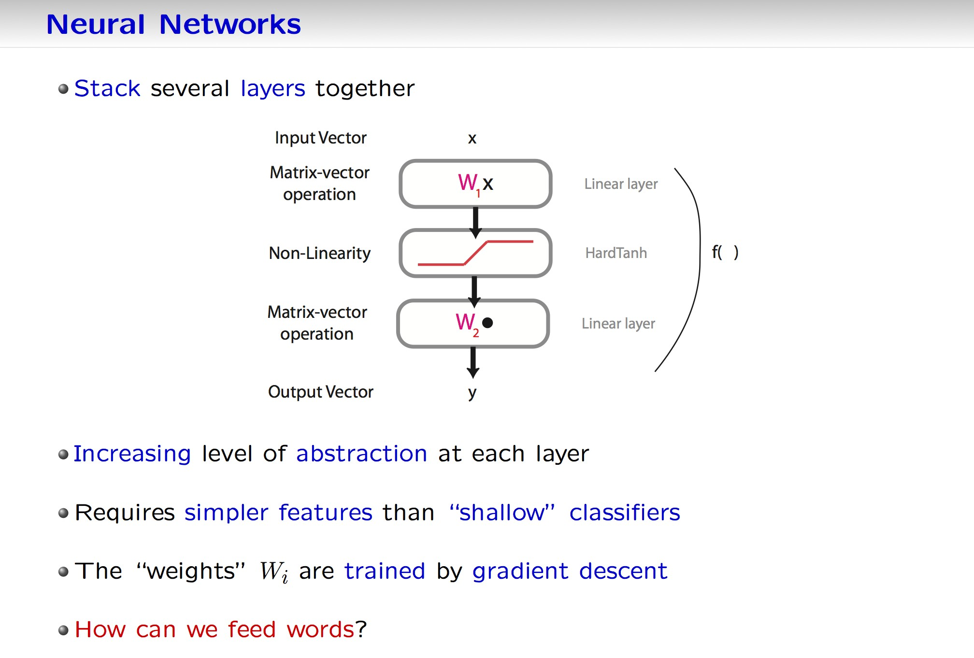
Neural networks
Stack several layers together
Increasing level of abstraction at each layer
Requires simpler features than “shallow” classifiers
The “weights” W_{i} are trained by gradient descent
How can we feed words?

Slide 47
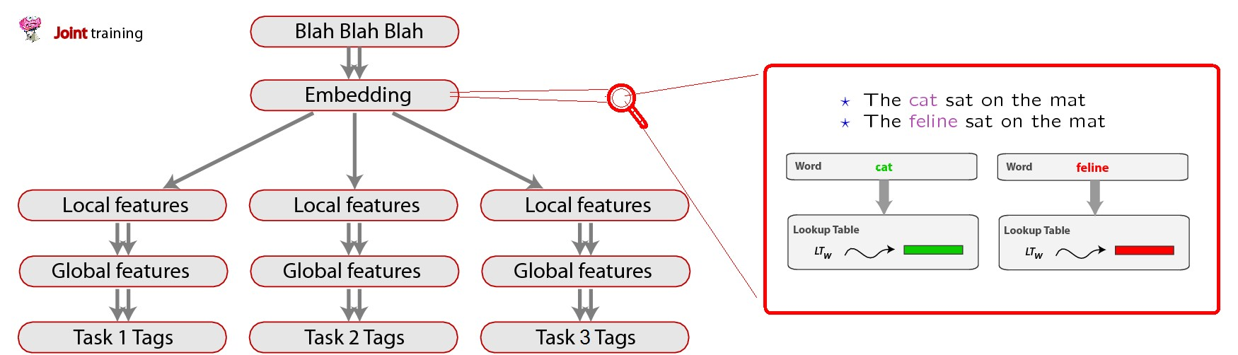
The big picture
A unified architecture for all NLP (labeling) tasks:
Sentence: | Felix | sat | on | the | mat | .
POS: | NNP | VBD | IN | DT | NN | .
CHUNK: | NP | VP | PP | NP | NP-I | .
NER: | PER | - | - | - | - | -
SRL: | ARG1 | REL | ARG2 | ARG2-I | ARG2-I | -

Slide 48
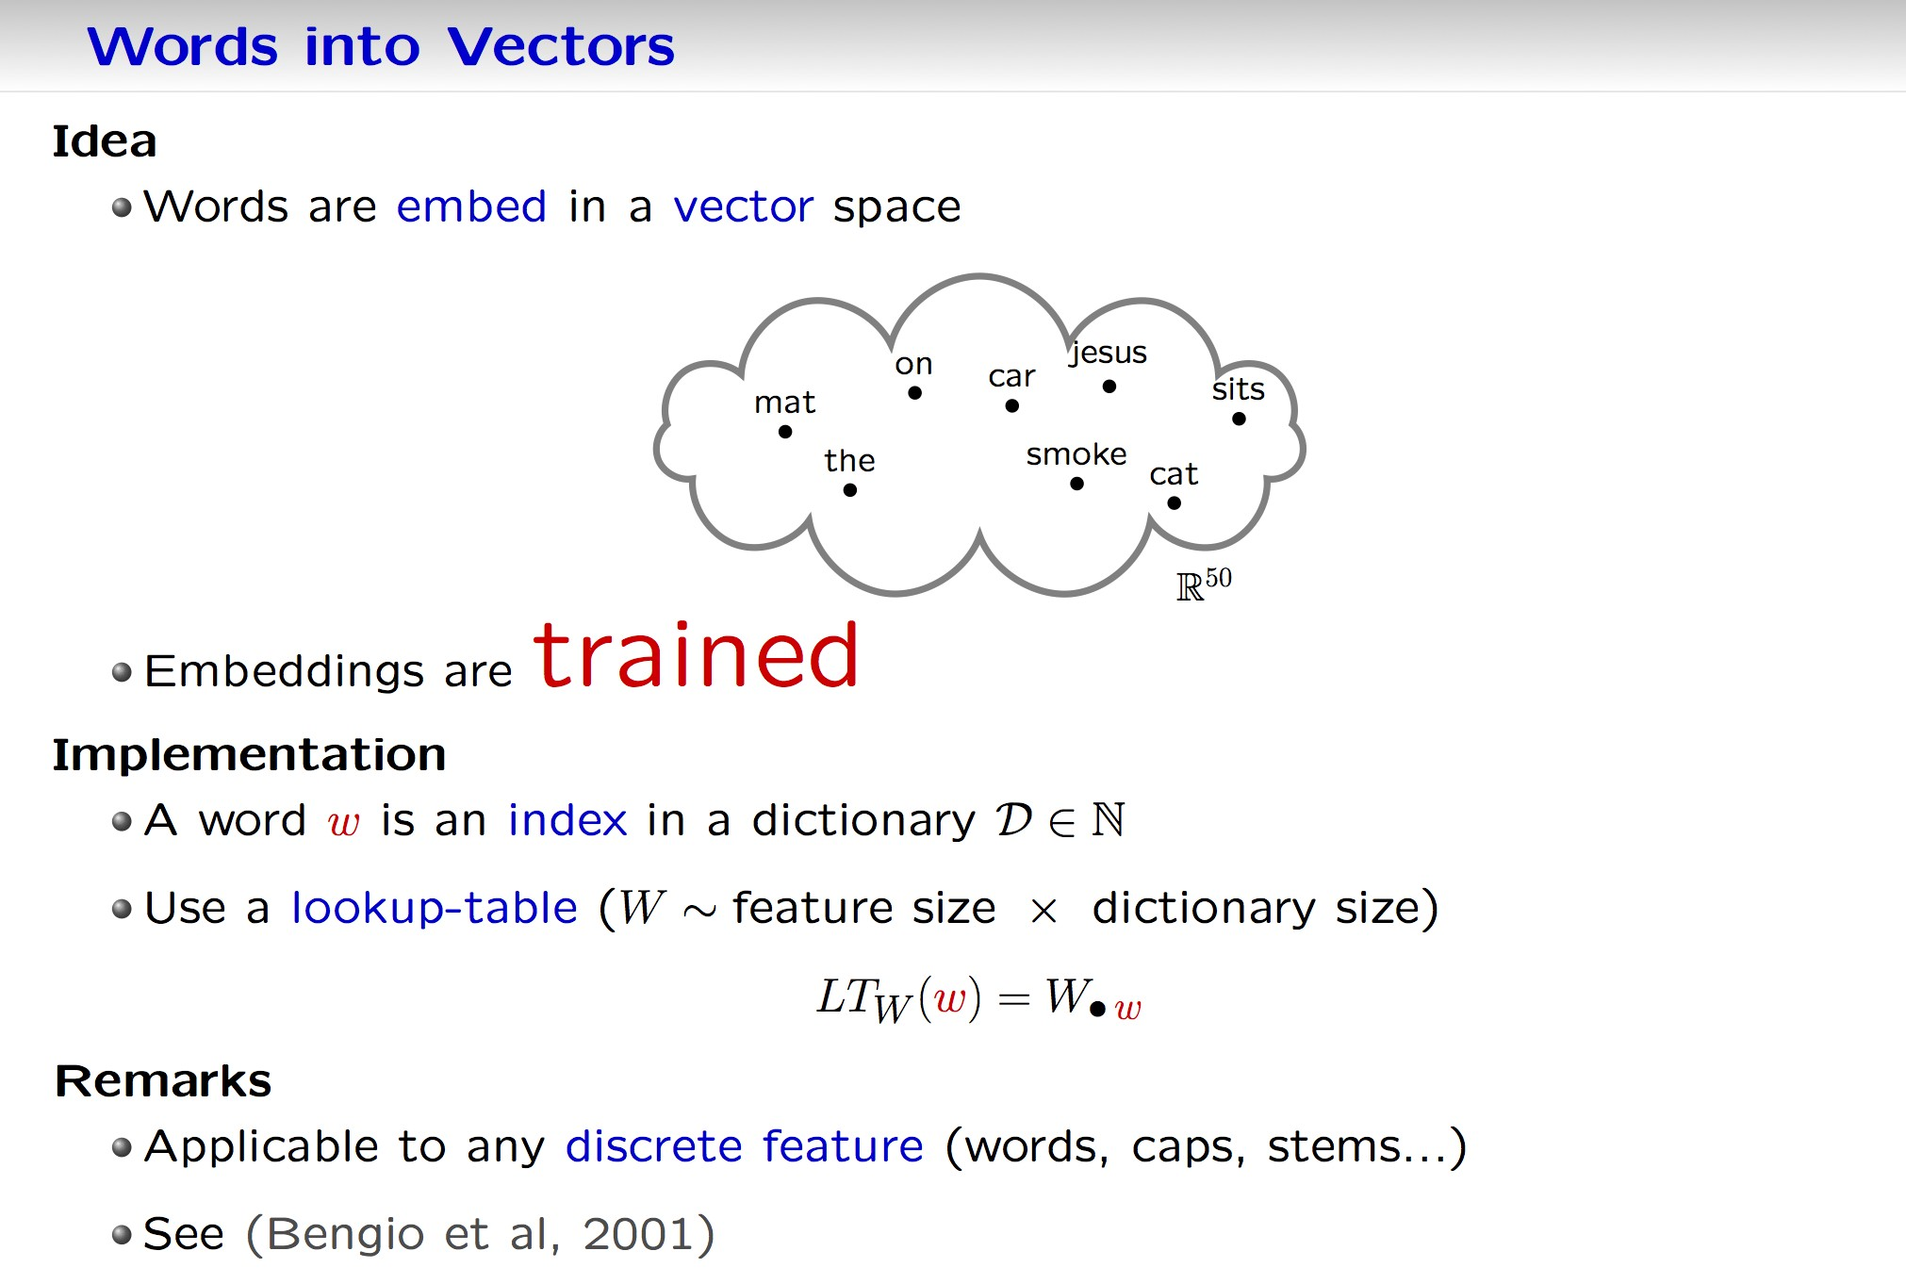
Words into vectors
Idea
Words are embed in a vector space
Embeddings are trained
Implementation
A word w is an index in a dictionary
Use a lookup-table (W ~ feature size x dictionary size)
Remarks
Applicable to any discrete feature (words, caps, stems…)
See (Bengio et al, 2001)

Slide 49
The lookup tables
Each word/element in dictionary maps to a vector in R^{d} .
We learn these vectors.
LookupTable: input of i^{th} word is
x = (0, 0, . . . , 1, 0, . . . , 0) 1 at position i
In the original space words are orthogonal.
cat = (0,0,0,0,0,0,0,0,0,1,0,0,0,0, . . . )
kitten = (0,0,1,0,0,0,0,0,0,0,0,0,0,0, . . . )
To get the R^{d} embedding vector for the word we multiply Wx where
W is a d × N vector with N words in the dictionary.

Slide 50
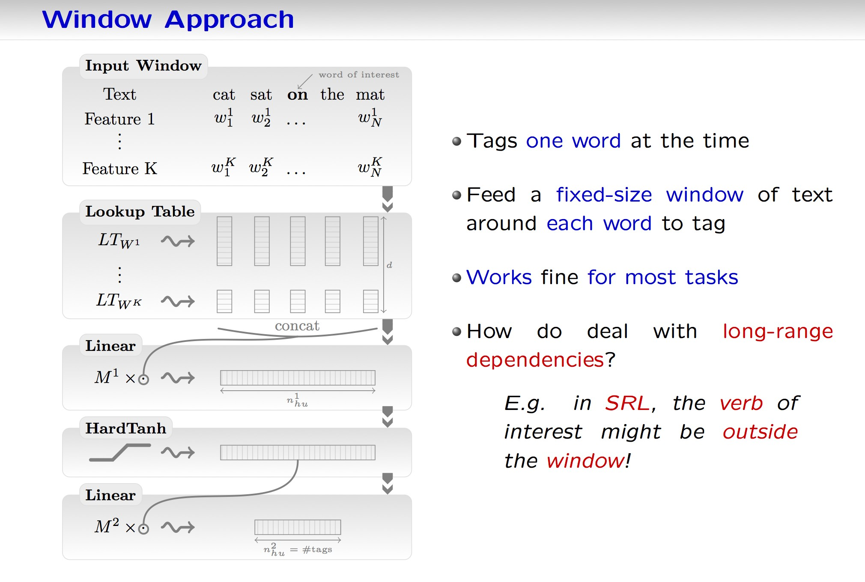
Window approach
Tags one word at the time
Feed a fixed-size window of text around each word to tag
Works fine for most tasks
How do deal with long-range dependencies?
E.g. in SRL, the verb of interest might be outside the window!

Slide 51
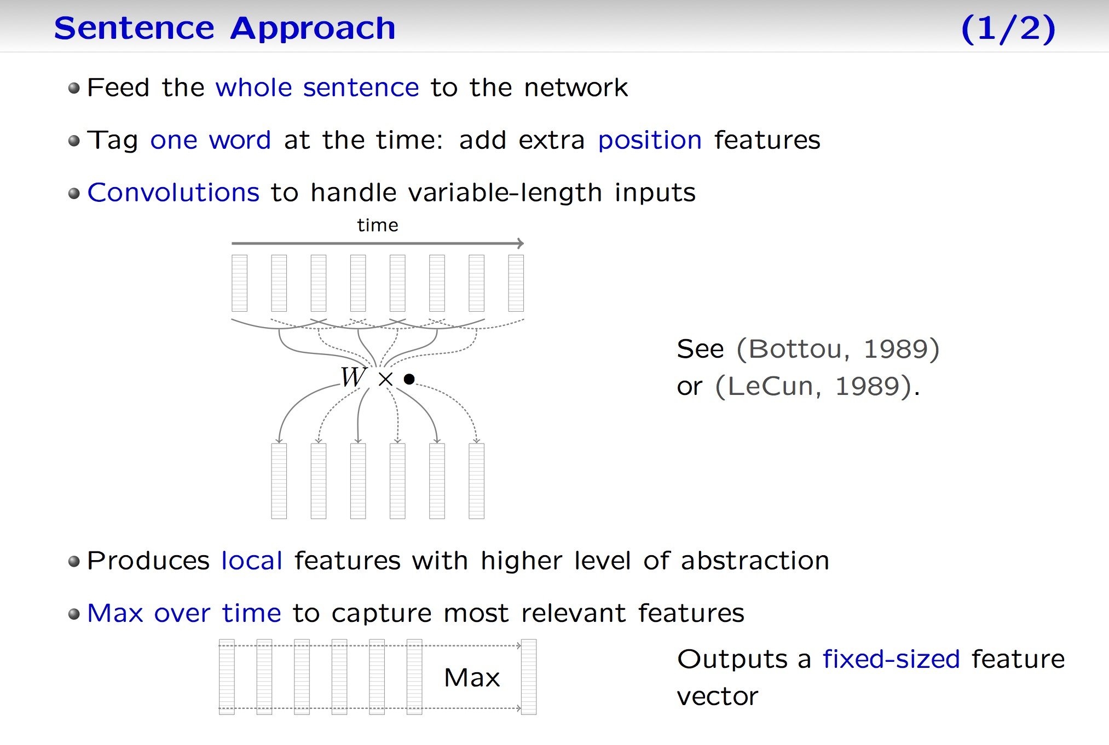
Sentence approach (1/2)
Feed the whole sentence to the network
Tag one word at the time: add extra position features
Convolutions to handle variable-length inputs
See (Bottou, 1989) or (LeCun, 1989)
Produces local features with higher level of abstraction
Max over time to capture most relevant features
Outputs a fixed-sized feature vector

Slide 52
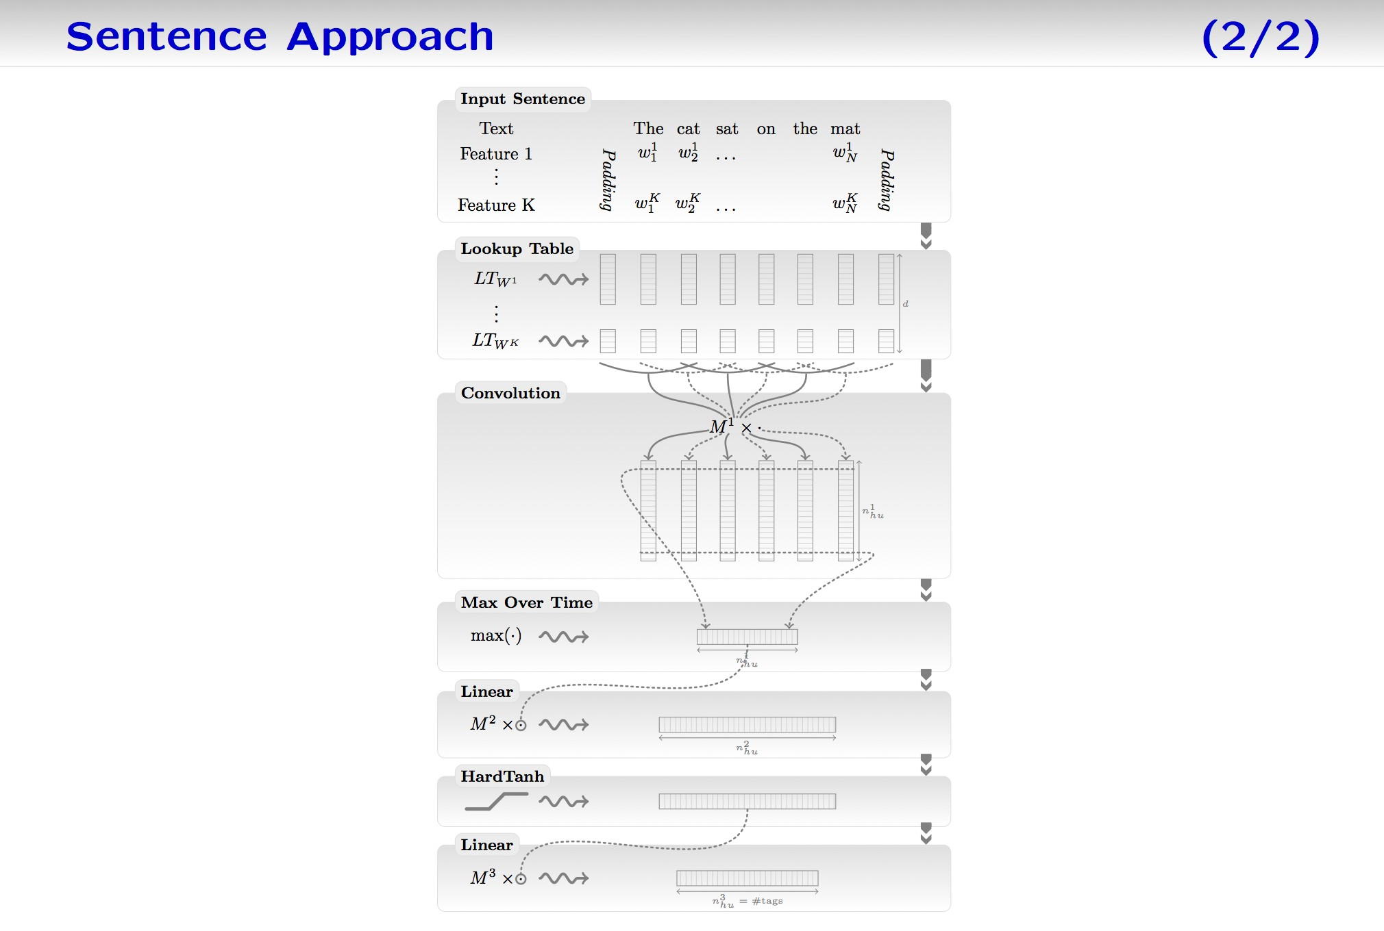
Sentence approach (2/2)

Slide 53

Deep SRL
Input Sentence
Blah Blah Blah
word of interest verb of interest
the cat sat on the mat
s(1) s(2) s(3) s(4) s(5) s(6)
Convolution Layer
Local features
text
indices
pos w.rt. word pos w.r.t. verb
...
-1 0 1 2 3 4
-2 -1 0 1 2 3
Max Over Time
...
Lookup Tables
Global features
Embedding
HardTanh
LT_{w}
LT_{pw} LT_{pv}
Linear
HardTanh
Linear
Softmax
Tags
This is the network for a single window. We train/test predicting the entire sentence of tags (“structured outputs”) using viterbi approach, similar to other NLP methods.

Slide 54
Removing the time dimension (1/2)

Slide 55
Removing the time dimension (2/2)

Slide 56
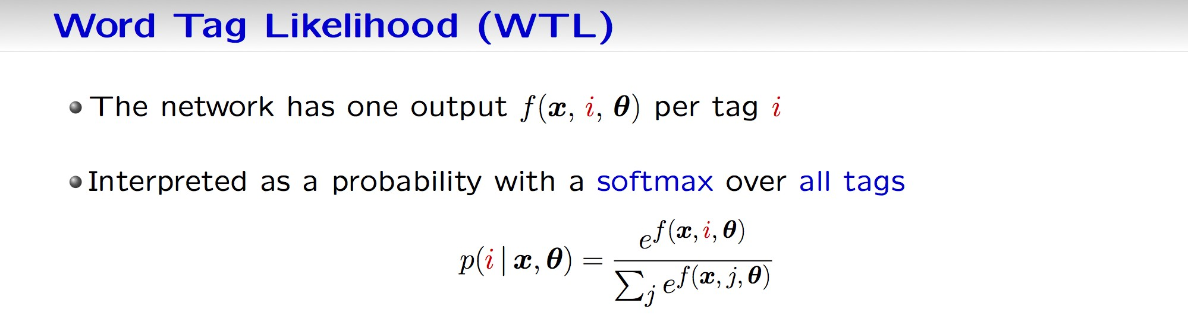
Word Tag Likelihood (WTL)
The network has one output per tag
Interpreted as a probability with a softmax over all tags
…we can train directly for that (word tag likelihood) or we could train in a structured way by predicting the entire sentence’s tags
That should be useful because tags are not independent

Slide 57
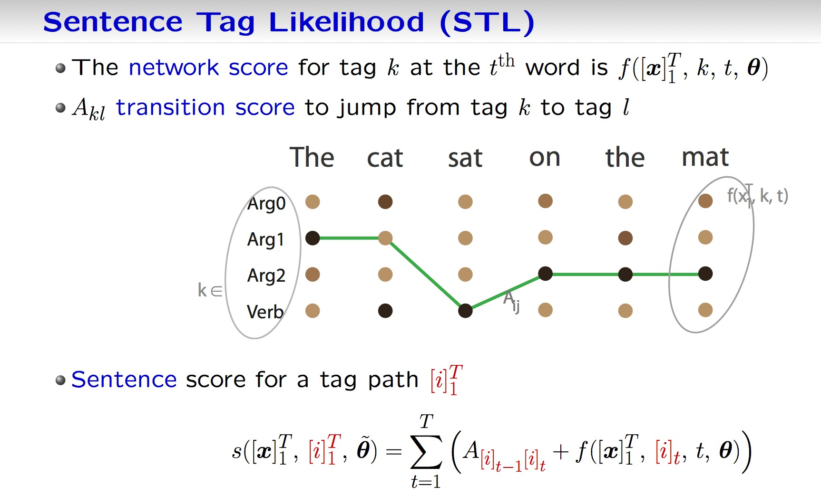
Sentence Tag Likelihood (STL)
The network score for tag k at the t^{th} word is
A_{kl} transition score to jump from tag k to tag l
Sentence score for a tag path

Slide 58
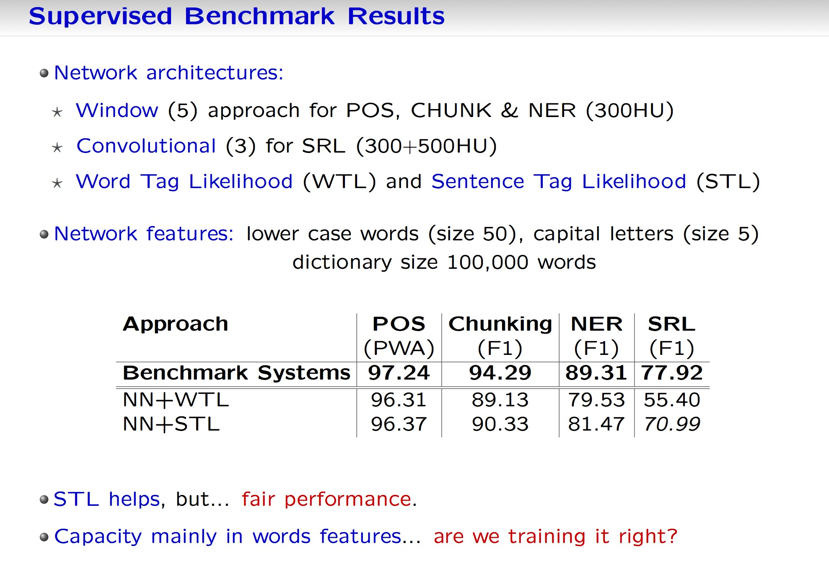
Supervised benchmark results
Network architectures:
Window (5) approach for POS, CHUNK & NER (300HU)
Convolutional (3) for SRL (300+500HU)
Word Tag Likelihood (WTL) and Sentence Tag Likelihood (STL)
Network features: lower case words (size 50), capital letters (size 5) dictionary size 100,000 words
STL helps, but… fair performance
Capacity mainly in words features… are we training it right?

Slide 59
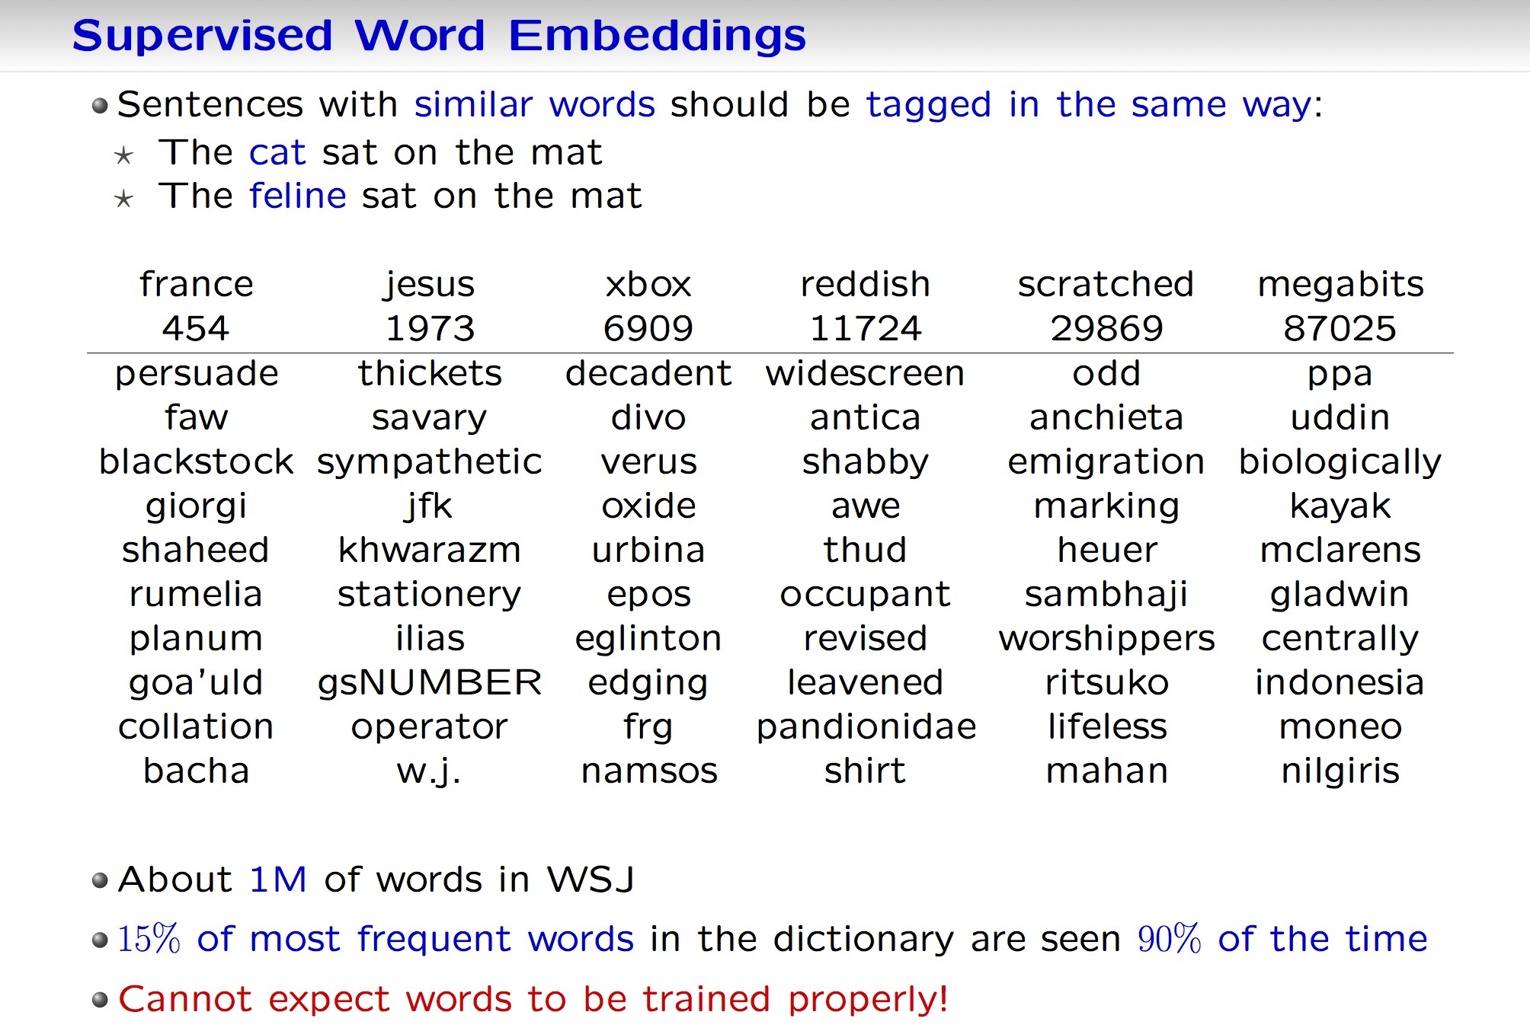
Supervised word embeddings
Sentences with similar words should be tagged in the same way:
The cat sat on the mat
The feline sat on the mat
About 1M of words in WSJ
15% of most frequent words in the dictionary are seen 90% of the time
Cannot expect words to be trained properly!

Slide 60
Improving word embedding
Rare words are not trained properly
Sentences with similar words should be tagged in the same way:
The cat sat on the mat
The feline sat on the mat
Only 1M WSJ not enough – let’s use lots of unsupervised data!

Slide 61
Semi-supervised: MTL with unlabeled text
Language Model: “is a sentence actually english or not?”
Implicitly captures: * syntax * semantics
Bengio & Ducharme (2001) Probability of next word given previous words. Overcomplicated – we do not need probabilities here
English sentence windows: Wikipedia (∼ 631M words)
Non-english sentence windows: middle word randomly replaced
the champion federer wins wimbledon
vs. the champion saucepan wins wimbledon
Multi-class margin cost:

Slide 62
Language model: embedding
Nearest neighbors in 100-dim. embedding space:
(Even fairly rare words are embedded well.)

Slide 63
Results
Algorithm | POS (PWA) | CHUNK (F1) | NER (F1) | SRL (F1)
Baselines | 97.24 [Toutanova ’03] | 94.29 [Sha ’03] | 89.31 [Ando ’05] | 77.92 [Koomen ’05]
NN + WTL | 96.31 | 89.13 | 79.53 | 55.40
NN + STL | 96.37 | 90.33 | 81.47 | 70.99
NN + LM + STL | 97.22 | 94.10 | 88.67 | 74.15
NN + . . . + tricks | 97.29 [+suffix] | 94.32 [+POS] | 89.95 [+gazetteer] | 76.03 [+Parse Trees]
Notes:
Didn’t compare to benchmarks that used external labeled data.
[Ando ’05] uses external unlabeled data.
[Koomen ’05] uses 4 parse trees not provided by the challenge. Using only 1 tree it gets 74.76.

Slide 64
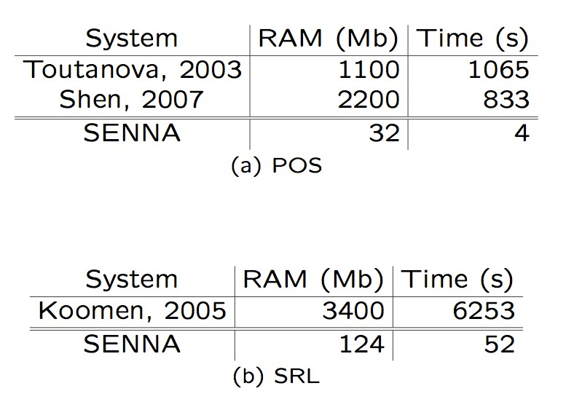
Software
Code for tagging with POS, NER, CHUNK, SRL + parse trees:
http://ml.nec-labs.com/senna/
See also Torch: http://www.torch.ch

Slide 65
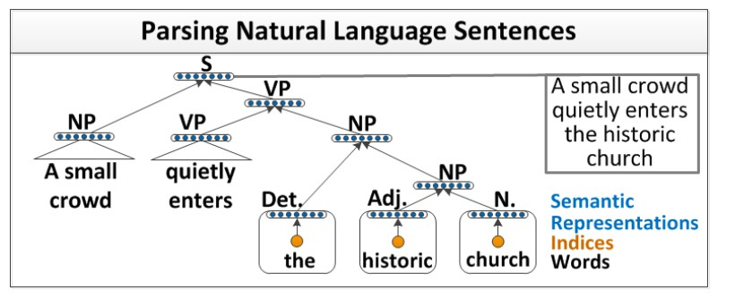
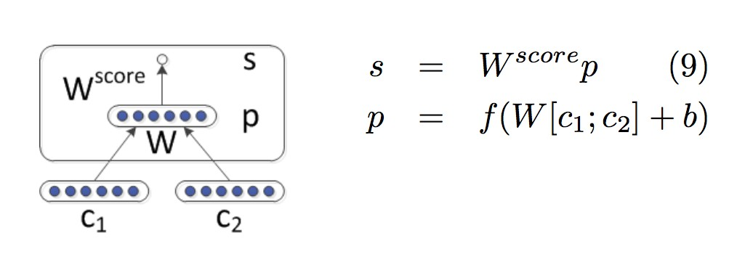
Recursive NNs for parsing, sentiment, ... and more!
(Socher et al., ICML ’13), (Socher et al., EMNLP, ’13))
Build sentence representations using the parse tree to compose embeddings via a nonlinear function taking pairs (c₁, c₂) and output p.

Slide 66
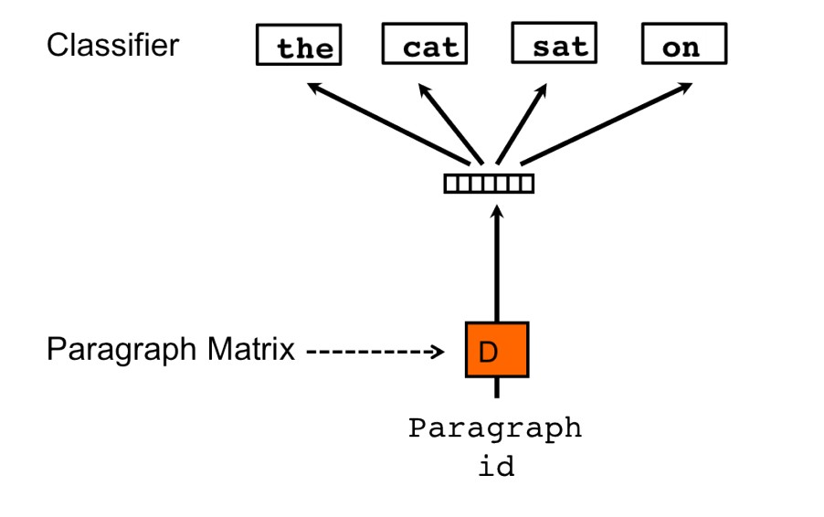
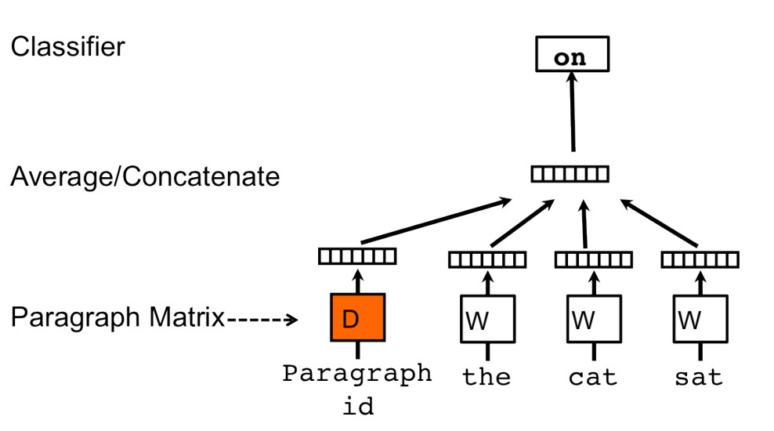
Paragraph vector
(Le & Mikolov, ’14)
A Paragraph Vector (a vector that represents a paragraph/doc) learned by:
1) Predicting the words in a doc; 2) predict n-grams in the doc:
At test time, for a new document, one needs to learn its vector, this can encode word order via the n-gram prediction approach.

Slide 67
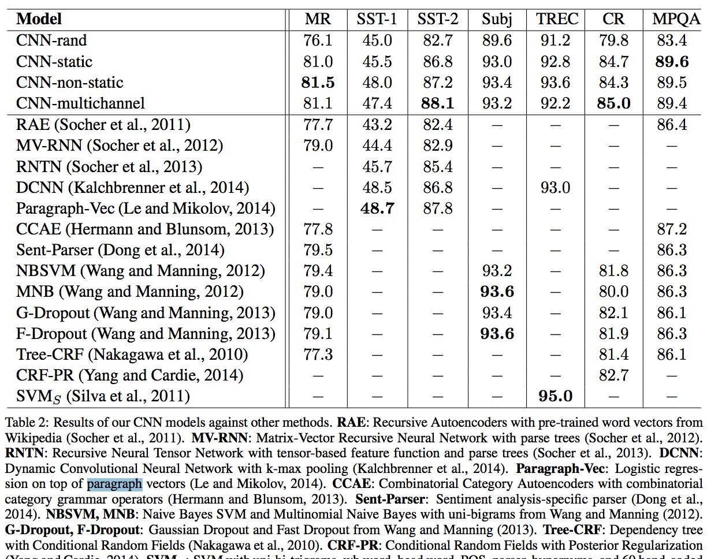
Comparison of CNN, RNN & PV (Kim ’14)

Slide 68
Some more recent work
Compositionality approaches by Marco Baroni’s group: Words are combined with linear matrices dependendent on the P.O.S.: G. Dinu and M. Baroni. How to make words with vectors: Phrase generation in distributional semantics. ACL ’14.
Document representation by Phil Blunson’s group: Variants of convolutional networks for text: Kalchbrenner et al. A Convolutional Neural Network for Modelling Sentences. ACL ’14
Good tutorial slides from these teams covering multiple topics: New Directions in Vector Space Models of Meaning http://www.cs.ox.ac.uk/files/6605/aclVectorTutorial.pdf

Slide 69
Summary
Generic end-to-end deep learning system for NLP tasks
Word embeddings combined to form sentence or document embeddings can perform well on supervised tasks.
Previous common belief in NLP: engineering syntactic features necessary for semantic tasks. One can do well by engineering a model/algorithm rather than features.
Attitude is changing in recent years... let’s see what happens!

Slide 70
Thank you

